Slide 1
THE Group 5
Students’ handbook and school webpage

Slide 2
AIM OF PRESENTATION
To build the first digital Student’s handbook website for Topfaith university.
To make easy collecting of information relating to the rules of the school that us students will use.

Slide 3
HTML tags used for programming
** <div>
** <td>, <th>, <tr>
** <button>
** <li>, <ul>
** <img>
** <label>, <p>,<h2>, <h3>
** <a>, <link>

Slide 4
Pictures of our webpage

Slide 5
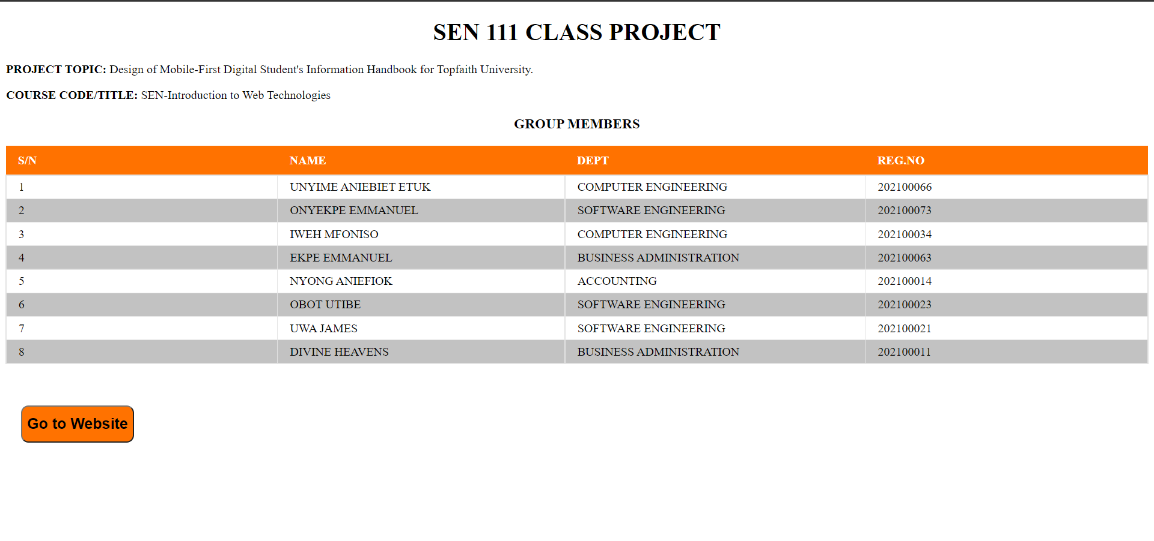

Slide 6
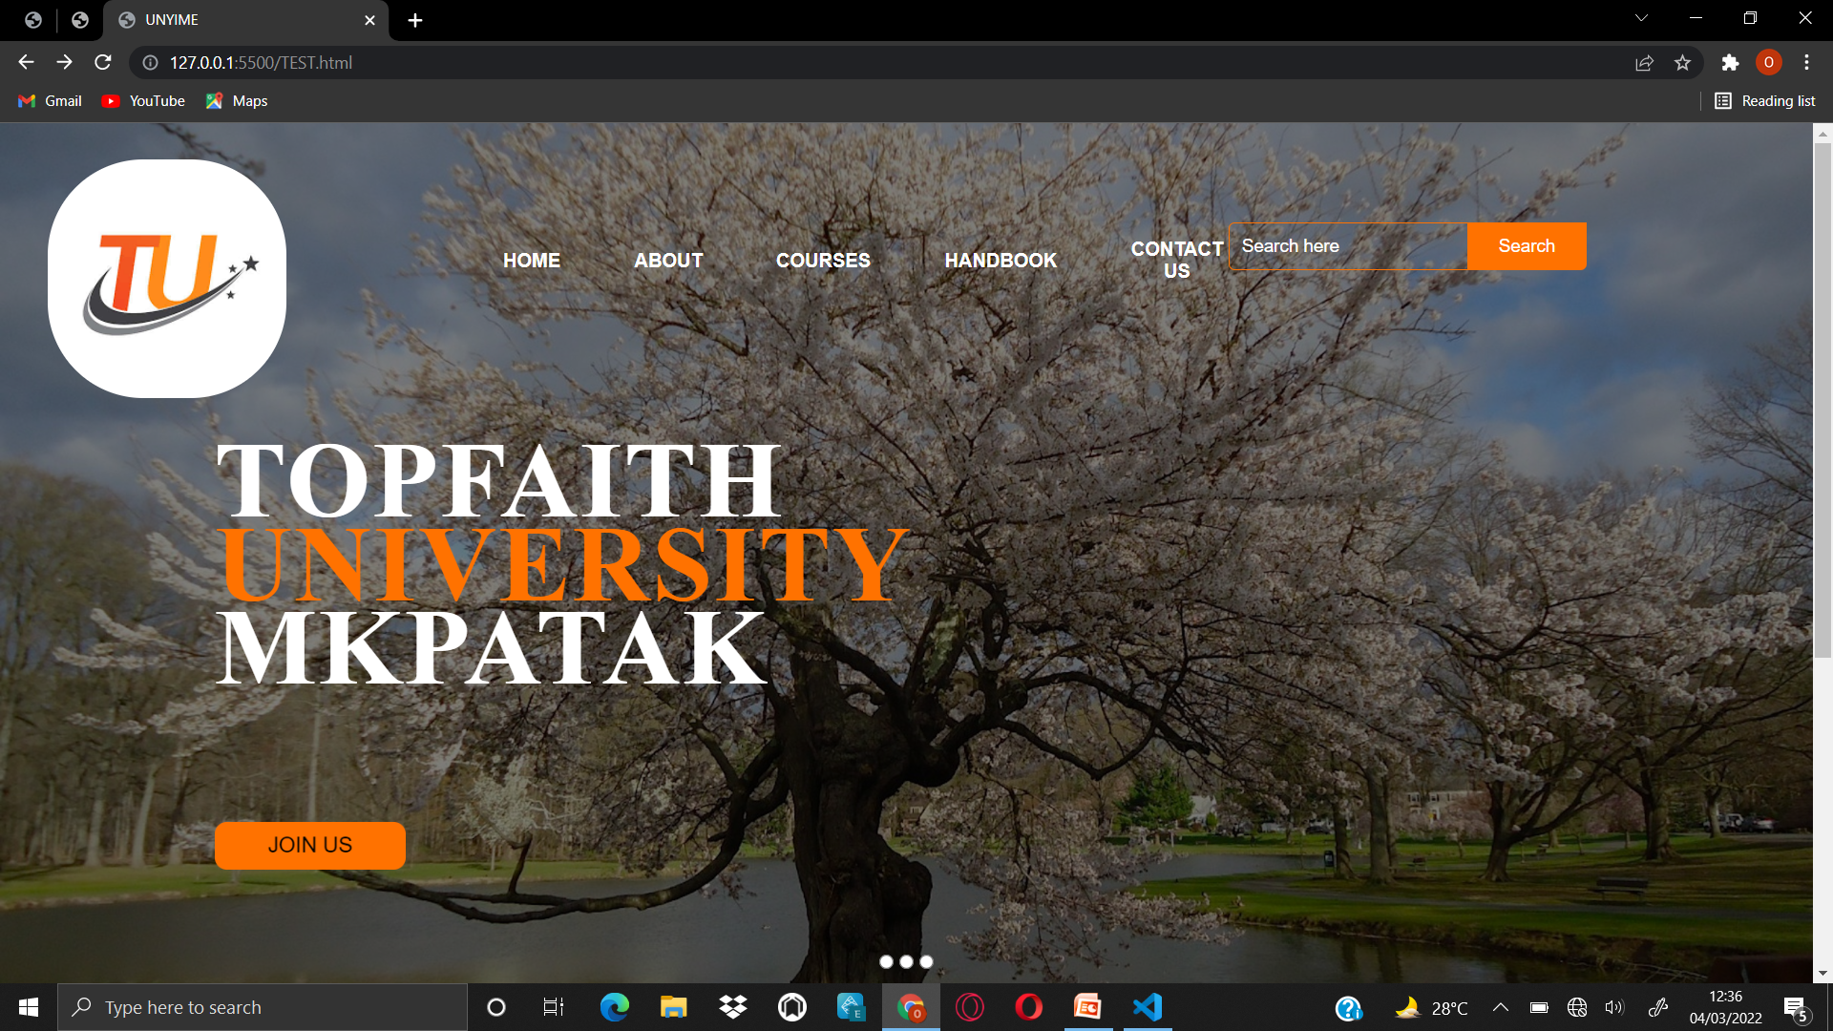

Slide 7
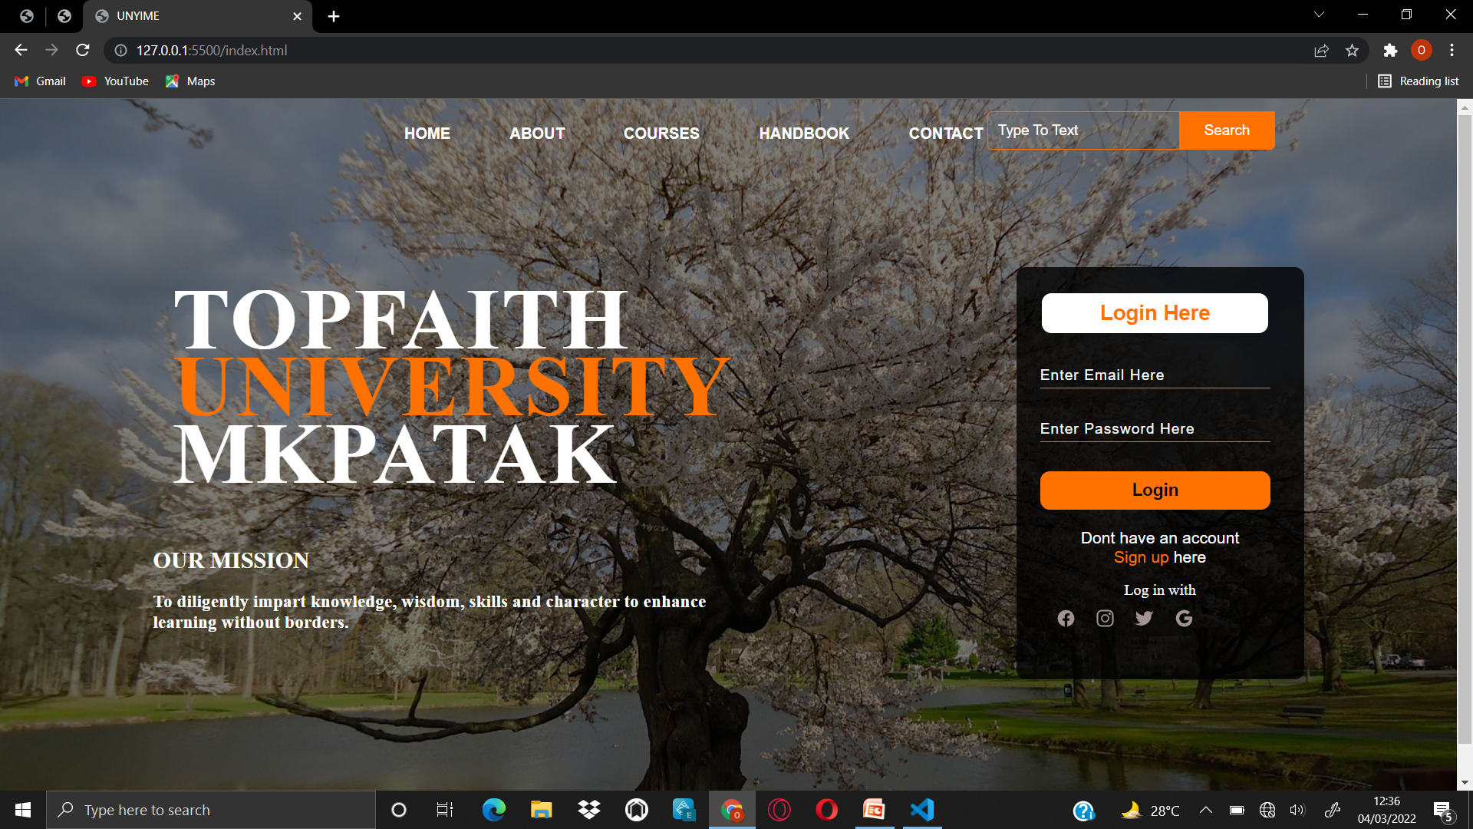

Slide 8
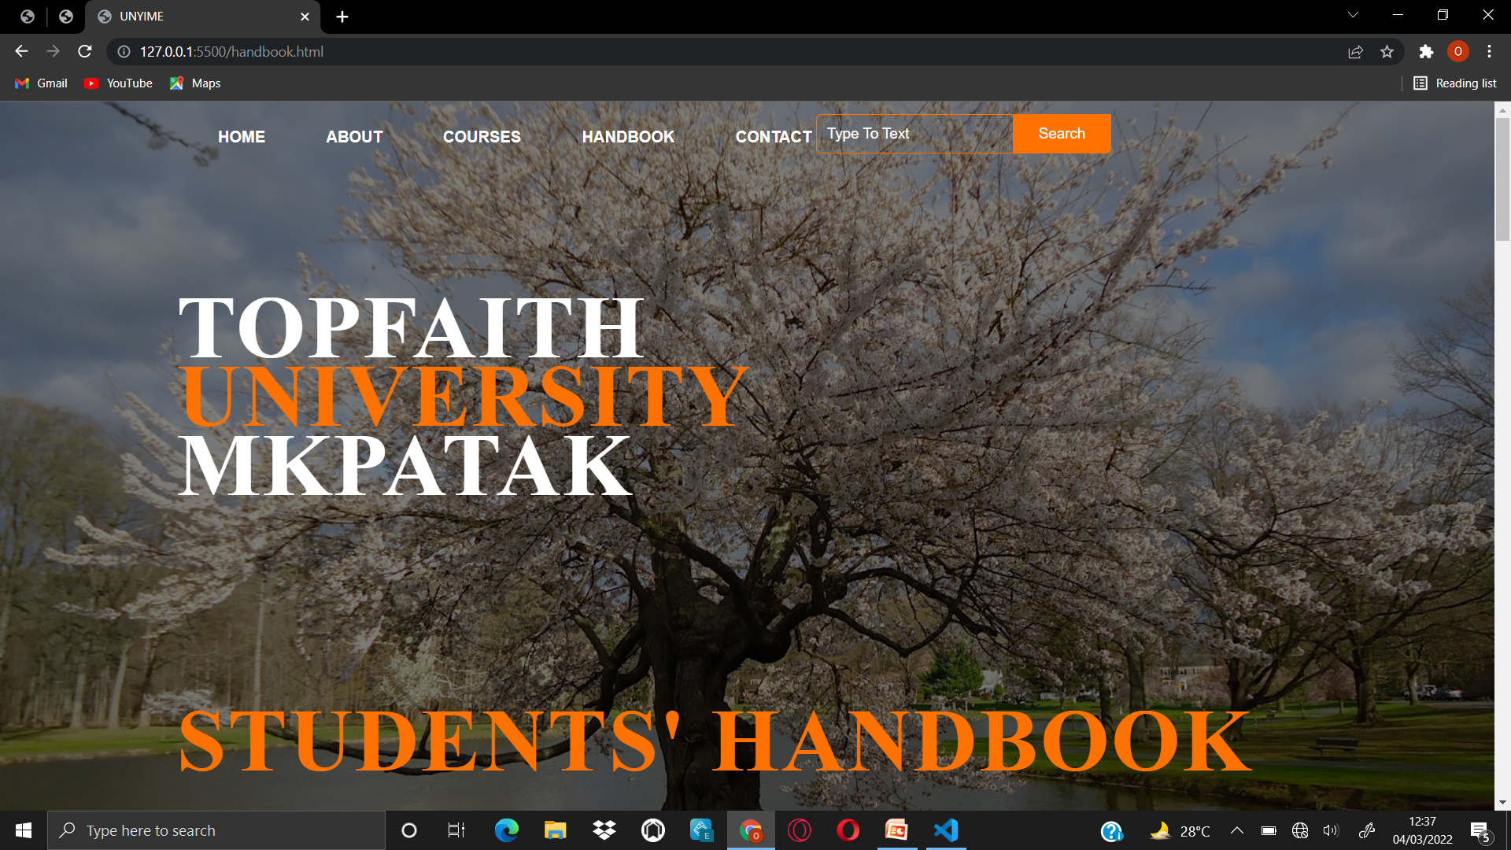

Slide 9
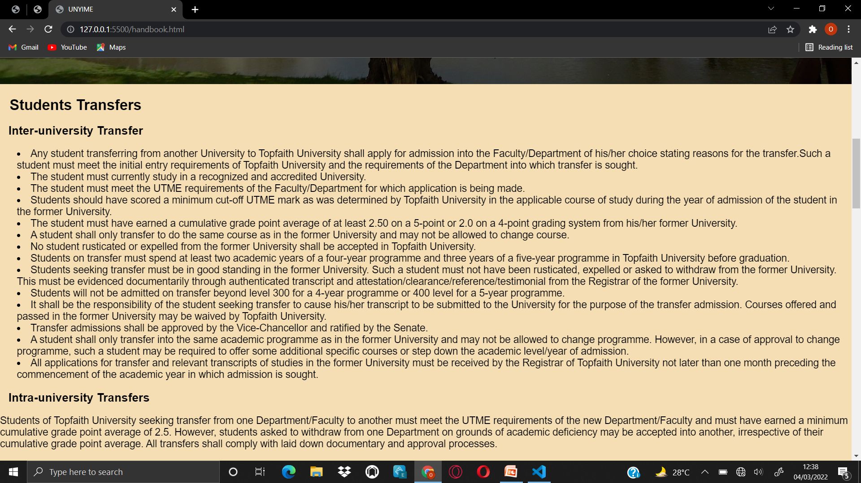

Slide 10
Thanks for watching

